Slide 1
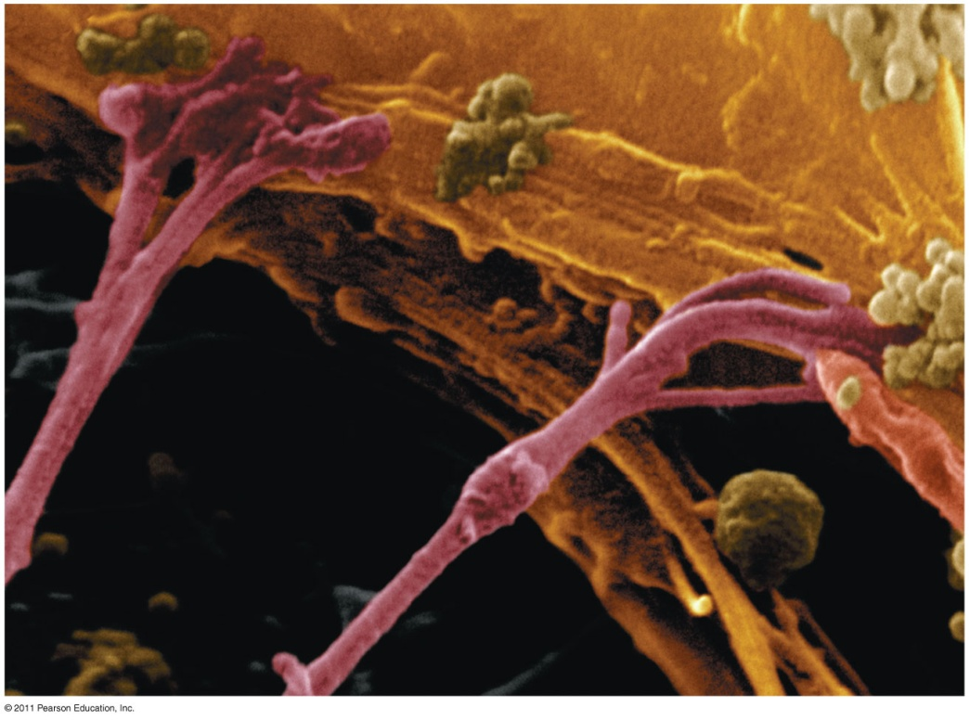
Chapter 6
A Tour of the Cell

Slide 2
The Fundamental Units of Life
All organisms are made of cells
Cell structure is correlated to cellular function
All cells are related by their descent from earlier cells

Slide 3
Biologists use microscopes
to study cells
Though usually too small to be seen by the unaided eye, cells can be complex

Slide 4
Microscopy
Scientists use microscopes to visualize cells too small to see with the naked eye
In a light microscope (LM), visible light is passed through a specimen and then through glass lenses
Lenses refract (bend) the light, so that the image is magnified

Slide 5
Microscopy
Three important parameters of microscopy
Magnification, the ratio of an object’s image size to its real size
Resolution, the measure of the clarity of the image, or the minimum distance of two distinguishable points
Contrast, visible differences in parts of the sample

Slide 6
Microscopy
Brightfield
unstained specimen

Slide 7
Microscopy
Brightfield
stained specimen)

Slide 8
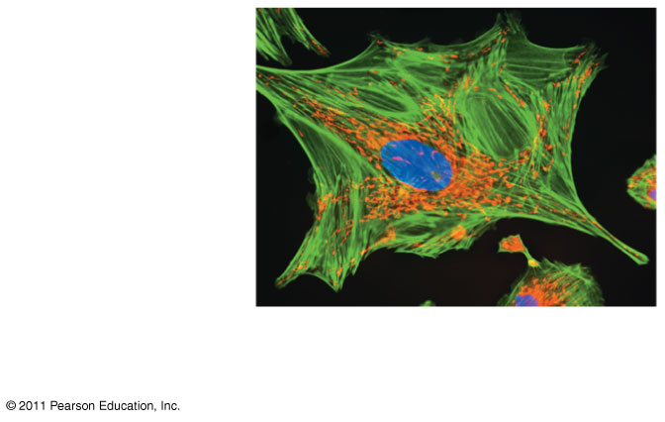
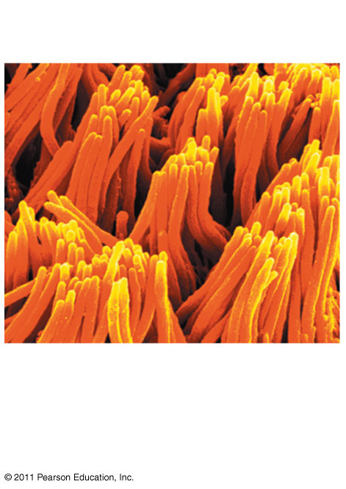
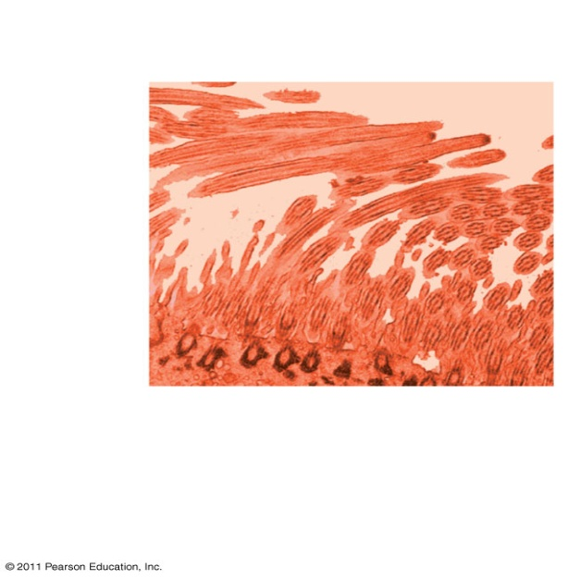
Microscopy
Fluorescence
Phase-contrast
Transmission electron microscopy (TEM)
Scanning electron microscopy (SEM

Slide 9
Microscopy
LMs can magnify effectively to about 1,000 times the size of the actual specimen
Various techniques enhance contrast and enable cell components to be stained or labeled
Most subcellular structures, including organelles (membrane-enclosed compartments), are too small to be resolved by an LM

Slide 10
Microscopy
Two basic types of electron microscopes (EMs) are used to study subcellular structures
Scanning electron microscopes (SEMs) focus a beam of electrons onto the surface of a specimen, providing images that look 3-D
Transmission electron microscopes (TEMs) focus a beam of electrons through a specimen
TEMs are used mainly to study the internal structure of cells

Slide 11
Cell Fractionation
Cell fractionation takes cells apart and separates the major organelles from one another
Centrifuges fractionate cells into their component parts
Cell fractionation enables scientists to determine the functions of organelles
Biochemistry and cytology help correlate cell function with structure

Slide 12
Cell Fractionation
Homogenization
Tissue cells
Homogenate
Centrifugation

Slide 13
Cell Fractionation
1,000 g
Differential centrifugation
Pellet rich in nuclei and cellular debris
20,000 g
80,000 g
Pellet rich in mitochondria (and chloro- plasts if cells are from a plant)
150,000 g
Pellet rich in “microsomes”
Pellet rich in ribosomes

Slide 14
Eukaryotic cells have internal membranes that compartmentalize their functions
The basic structural and functional unit of every organism is one of two types of cells: prokaryotic or eukaryotic
Only organisms of the domains Bacteria and Archaea consist of prokaryotic cells
Protists, fungi, animals, and plants all consist of eukaryotic cells

Slide 15
Comparing Prokaryotic and Eukaryotic Cells
Basic features of all cells:
Plasma membrane
Semifluid substance called cytosol
Chromosomes (carry genes)
Ribosomes (make proteins)

Slide 16
Prokaryotic Cells
Prokaryotic cells are characterized by having
No nucleus
DNA in an unbound region called the nucleoid
No membrane-bound organelles
Cytoplasm bound by the plasma membrane

Slide 17
Prokaryotic Cells
A typical rod-shaped bacterium
A thin section through the bacterium Bacillus coagulans (TEM)

Slide 18
Eukaryotic Cells
Eukaryotic cells are characterized by having
DNA in a nucleus that is bounded by a membranous nuclear envelope
Membrane-bound organelles
Cytoplasm in the region between the plasma membrane and nucleus
Eukaryotic cells are generally much larger than prokaryotic cells

Slide 19
Eukaryotic Cells
The plasma membrane is a selective barrier that allows sufficient passage of oxygen, nutrients, and waste to service the volume of every cell
The general structure of a biological membrane is a double layer of phospholipids

Slide 20
Plasma membrane
Hydrophilic region
Hydrophobic region
Structure of the plasma membrane

Slide 21
Eukaryotic cell’s genetic instructions
The nucleus contains most of the DNA in a eukaryotic cell
Ribosomes use the information from the DNA to make proteins

Slide 22
Nucleus
The nucleus contains most of the cell’s genes
The nuclear envelope encloses the nucleus, separating it from the cytoplasm
In the nucleus, DNA is organized into discrete units called chromosomes
Each chromosome is composed of a single DNA molecule associated with proteins
The DNA and proteins of chromosomes are together called chromatin

Slide 23
Ribosomes: Protein Factories
Ribosomes carry out protein synthesis in two locations
In the cytosol (free ribosomes)
On the outside of the endoplasmic reticulum or the nuclear envelope (bound ribosomes)

Slide 24
The Endoplasmic Reticulum: Biosynthetic Factory
There are two distinct regions of ER
Smooth ER, which lacks ribosomes
Rough ER, surface is studded with ribosomes

Slide 25
Endoplasmic Reticulum
Smooth ER
Rough ER

Slide 26
Functions of Smooth ER
The smooth ER:
Synthesizes lipids
Metabolizes carbohydrates
Detoxifies drugs and poisons
Stores calcium ions

Slide 27
Functions of Rough ER
The rough ER:
Has bound ribosomes, which secrete glycoproteins (proteins covalently bonded to carbohydrates)
Distributes transport vesicles, proteins surrounded by membranes

Slide 28
Lysosomes: Digestive Compartments
A lysosome is a membranous sac of hydrolytic enzymes that can digest macromolecules
Lysosomal enzymes can hydrolyze proteins, fats, polysaccharides, and nucleic acids
Lysosomal enzymes work best in the acidic environment inside the lysosome

Slide 29
Lysosomes
Some types of cell can engulf another cell by phagocytosis; this forms a food vacuole
A lysosome fuses with the food vacuole and digests the molecules
Lysosomes also use enzymes to recycle the cell’s own organelles and macromolecules

Slide 30
Lysosomes
Lysosome
Digestion
Food vacuole
Phagocytosis

Slide 31
Mitochondria and chloroplasts change energy from one form to another
Mitochondria are the sites of cellular respiration, a metabolic process that uses oxygen to generate ATP
Chloroplasts, found in plants and algae, are the sites of photosynthesis

Slide 32
The Evolutionary Origins of Mitochondria and Chloroplasts
Mitochondria and chloroplasts have similarities with bacteria:
Enveloped by a double membrane
Contain free ribosomes and circular DNA molecules
Grow and reproduce somewhat independently in cells

Slide 33
Origins of Mitochondria
The Endosymbiont theory:
An early ancestor of eukaryotic cells engulfed a nonphotosynthetic prokaryotic cell, which formed an endosymbiont relationship with its host
The host cell and endosymbiont merged into a single organism, a eukaryotic cell with a mitochondrion

Slide 34
Chloroplasts: Capture of Light Energy
Chloroplasts contain the green pigment chlorophyll, as well as enzymes and other molecules that function in photosynthesis
Chloroplasts are found in leaves and other green organs of plants and in algae

Slide 35
The cytoskeleton
The cytoskeleton is a network of fibers extending throughout the cytoplasm
It organizes the cell’s structures and activities, anchoring many organelles
It is composed of three types of molecular structures
Microtubules
Microfilaments
Intermediate filaments

Slide 36
Roles of the Cytoskeleton: Support and Motility
The cytoskeleton helps to support the cell and maintain its shape
It interacts with motor proteins to produce motility

Slide 37
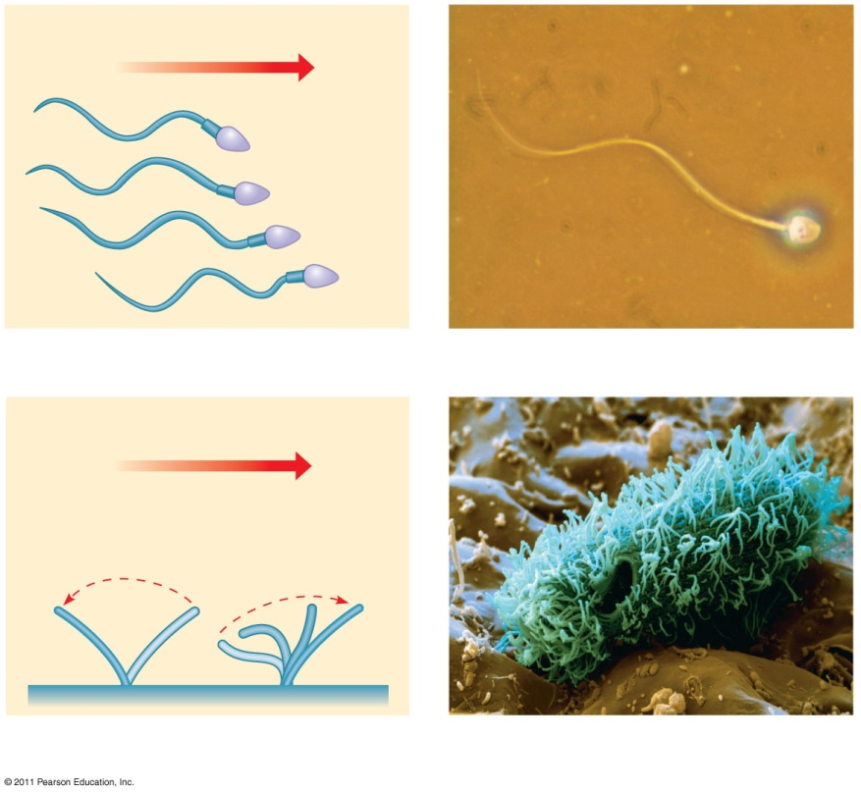
Cilia and Flagella
Microtubules control the beating of cilia and flagella, locomotor appendages of some cells
Cilia and flagella differ in their beating patterns
Direction of swimming
Motion of flagella
Motion of cilia

Slide 38
Cells
Cytoplasmic streaming is a circular flow of cytoplasm within cells
This streaming speeds distribution of materials within the cell

Slide 39
Extracellular components and connections between cells help coordinate cellular activities
Most cells synthesize and secrete materials that are external to the plasma membrane
Functions of the ECM
Support
Adhesion
Movement
Regulation

Slide 40
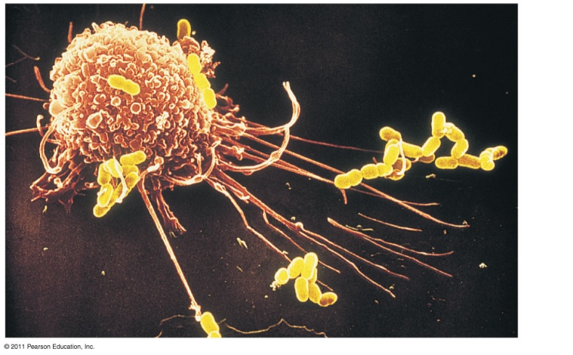
The Cell: A Living Unit Greater Than the Sum of Its Parts
Cells rely on the integration of structures and organelles in order to function
For example, a macrophage’s ability to destroy bacteria involves the whole cell, coordinating components such as the cytoskeleton, lysosomes, and plasma membrane

Slide 41
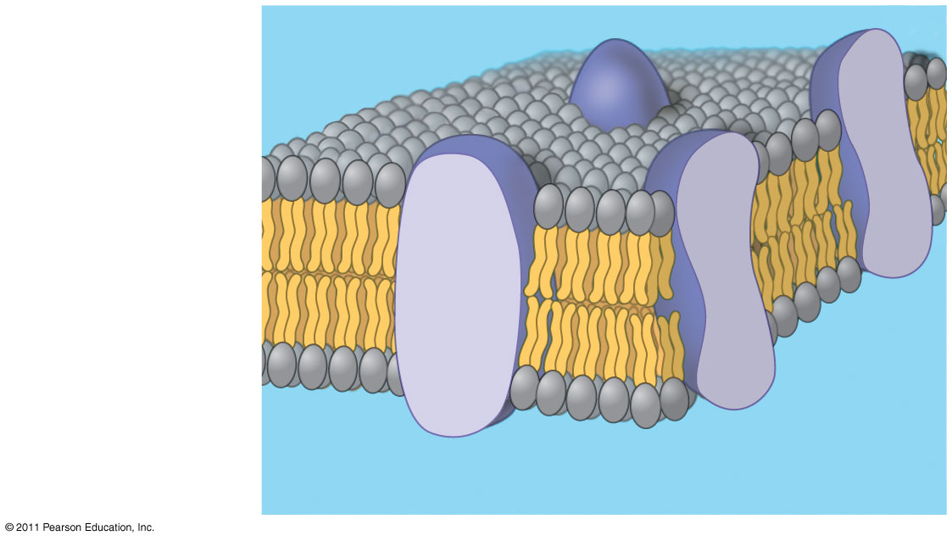
Chapter 7
Membrane Structure and Function
Phospholipid bilayer

Slide 42
Life at the Edge
The plasma membrane is the boundary that separates the living cell from its surroundings
The plasma membrane exhibits selective permeability, allowing some substances to cross it more easily than others

Slide 43
Cellular membranes are fluid mosaics of lipids and proteins
Phospholipids are the most abundant lipid in the plasma membrane
Phospholipids are amphipathic molecules, containing hydrophobic and hydrophilic regions
The fluid mosaic model states that a membrane is a fluid structure with a “mosaic” of various proteins embedded in it

Slide 44
Membrane Models: Scientific Inquiry
Membranes have been chemically analyzed and found to be made of proteins and lipids
Scientists studying the plasma membrane reasoned that it must be a phospholipid bilayer

Slide 45
Membrane Model
WATER
Hydrophilic head
Hydrophobic tail

Slide 46
Membrane Model
In 1972, S. J. Singer and G. Nicolson proposed that the membrane is a mosaic of proteins dispersed within the bilayer, with only the hydrophilic regions exposed to water
Freeze-fracture studies of the plasma membrane supported the fluid mosaic model
Freeze-fracture is a specialized preparation technique that splits a membrane along the middle of the phospholipid bilayer

Slide 47
The Fluidity of Membranes
Phospholipids in the plasma membrane can move within the bilayer
Most of the lipids, and some proteins, drift laterally
Rarely does a molecule flip-flop transversely across the membrane

Slide 48
The Fluidity of Membranes

Slide 49
Do membrane proteins move?
Hybrid cell
Membrane proteins
Mixed proteins after 1 hour
Mouse cell
Human cell

Slide 50
The Fluidity of Membranes
As temperatures cool, membranes switch from a fluid state to a solid state
The temperature at which a membrane solidifies depends on the types of lipids
Membranes rich in unsaturated fatty acids are more fluid than those rich in saturated fatty acids
Membranes must be fluid to work properly; they are usually about as fluid as salad oil

Slide 51
Evolution of Differences in Membrane Lipid Composition
Variations in lipid composition of cell membranes of many species appear to be adaptations to specific environmental conditions
Ability to change the lipid compositions in response to temperature changes has evolved in organisms that live where temperatures vary

Slide 52
Membrane Proteins and Their Functions
A membrane is a collage of different proteins, often grouped together, embedded in the fluid matrix of the lipid bilayer
Proteins determine most of the membrane’s specific functions
Peripheral proteins are bound to the surface of the membrane
Integral proteins penetrate the hydrophobic core

Slide 53
Membrane Proteins and Their Functions
Six major functions of membrane proteins:
Transport
Enzymatic activity
Signal transduction
Cell-cell recognition
Intercellular joining
Attachment to the cytoskeleton and extracellular matrix (ECM)

Slide 54
Membrane Proteins and Their Functions
Signaling molecule
Enzymes
Receptor
a) Transport
) Enzymatic activity
Signal transduction

Slide 55
Membrane Proteins and Their Functions
Cell-cell recognition
Intercellular joining
Attachment to the cytoskeleton and extracellular matrix (ECM

Slide 56
Membrane structure results in selective permeability
A cell must exchange materials with its surroundings, a process controlled by the plasma membrane
Plasma membranes are selectively permeable, regulating the cell’s molecular traffic

Slide 57
The Permeability of the Lipid Bilayer
Hydrophobic (nonpolar) molecules, such as hydrocarbons, can dissolve in the lipid bilayer and pass through the membrane rapidly
Polar molecules, such as sugars, do not cross the membrane easily

Slide 58
Transport Proteins
Transport proteins allow passage of hydrophilic substances across the membrane
Some transport proteins, called channel proteins, have a hydrophilic channel that certain molecules or ions can use as a tunnel
Channel proteins called aquaporins facilitate the passage of water

Slide 59
Transport Proteins
Other transport proteins, called carrier proteins, bind to molecules and change shape to shuttle them across the membrane
A transport protein is specific for the substance it moves

Slide 60
Passive transport
is diffusion of a substance across a membrane with no energy investment
Diffusion is the tendency for molecules to spread out evenly into the available space
Although each molecule moves randomly, diffusion of a population of molecules may be directional

Slide 61
Passive transport
Molecules of dye
Net diffusion
Net diffusion
Equilibrium
Diffusion of one solute

Slide 62
Passive transport
Substances diffuse down their concentration gradient, the region along which the density of a chemical substance increases or decreases
No work must be done to move substances down the concentration gradient
The diffusion of a substance across a biological membrane is passive transport because no energy is expended by the cell to make it happen

Slide 63
Effects of Osmosis on Water Balance
Osmosis is the diffusion of water across a selectively permeable membrane
Water diffuses across a membrane from the region of lower solute concentration to the region of higher solute concentration until the solute concentration is equal on both sides

Slide 64
Effects of Osmosis on Water Balance
Lower concentration of solute (sugar
Same concentration of solute
Higher concentration of solute
Osmosis

Slide 65
Water Balance of Cells Without Walls
Tonicity is the ability of a surrounding solution to cause a cell to gain or lose water
Isotonic solution: Solute concentration is the same as that inside the cell; no net water movement across the plasma membrane
Hypertonic solution: Solute concentration is greater than that inside the cell; cell loses water
Hypotonic solution: Solute concentration is less than that inside the cell; cell gains water

Slide 66
Water Balance
Isotonic solution
Hypotonic solution
Hypertonic solution
H₂O
H₂O
H₂O
Animal cell
Plant cell

Slide 67
Water Balance
Hypertonic or hypotonic environments create osmotic problems for organisms
Osmoregulation, the control of solute concentrations and water balance, is a necessary adaptation for life in such environments

Slide 68
Facilitated Diffusion: Passive Transport Aided by Proteins
In facilitated diffusion, transport proteins speed the passive movement of molecules across the plasma membrane
Channel proteins provide corridors that allow a specific molecule or ion to cross the membrane
Channel proteins include:
Aquaporins, for facilitated diffusion of water

Slide 69
Passive Transport Aided by Proteins
A channel protein
Carrier proteins undergo a subtle change in shape that translocates the solute-binding site across the membrane
Carrier protein

Slide 70
Active transport uses energy to move solutes against their gradients
Facilitated diffusion is still passive because the solute moves down its concentration gradient, and the transport requires no energy
Active transport moves substances against their concentration gradients
Active transport requires energy, usually in the form of ATP
Active transport is performed by specific proteins embedded in the membranes

Slide 71
Bulk transport across the plasma membrane occurs by exocytosis and endocytosis
Small molecules and water enter or leave the cell through the lipid bilayer or via transport proteins
Large molecules, such as polysaccharides and proteins, cross the membrane in bulk via vesicles
Bulk transport requires energy

Slide 72
Exocytosis
In exocytosis, transport vesicles migrate to the membrane, fuse with it, and release their contents
Many secretory cells use exocytosis to export their products

Slide 73
Endocytosis
In endocytosis, the cell takes in macromolecules by forming vesicles from the plasma membrane
Endocytosis is a reversal of exocytosis, involving different proteins
There are three types of endocytosis:
Phagocytosis (“cellular eating”)
Pinocytosis (“cellular drinking”)
Receptor-mediated endocytosis

Slide 74
transport across the plasma membrane
In phagocytosis a cell engulfs a particle in a vacuole
In pinocytosis, molecules are taken up when extracellular fluid is “gulped” into tiny vesicles
In receptor-mediated endocytosis, binding of ligands to receptors triggers vesicle formation

Slide 75
transport across the plasma membrane

Slide 76
The End

